Slide 1

Cog-Ex: Technical Architecture

Slide 2


Logical Architecture
Presentation Layer
Reporting
Visualization
Analytics Layer
Function Specific Repositories
Statistical Models
Data Mining
Predictive Analytics
Natural Language Processing
Data Storage Layer
Data Lake
Stores the processed data and provides back up and recovery
Data Archival
Data
Ingestion Layer
Data Quality
Data Transformation
Data Management
Data
Sources

Slide 3


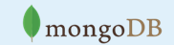







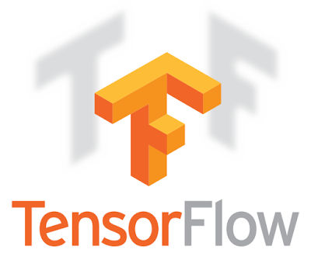
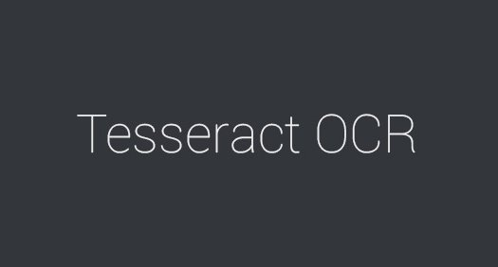


Solution Architecture
Source
Systems
User
Interface
Segment & Extract using Convolutional Neural Networks
Visualization
Convert & Load
Conversion Table
Feature Table
Document Master
Classification Table
Mapping Table
Classify & Map using Recursive Neural Networks

Slide 4

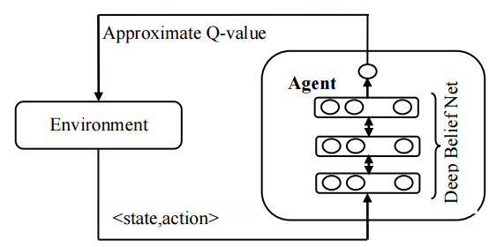
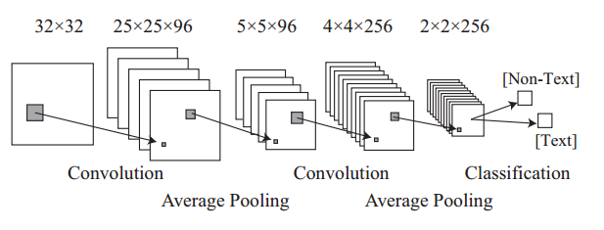
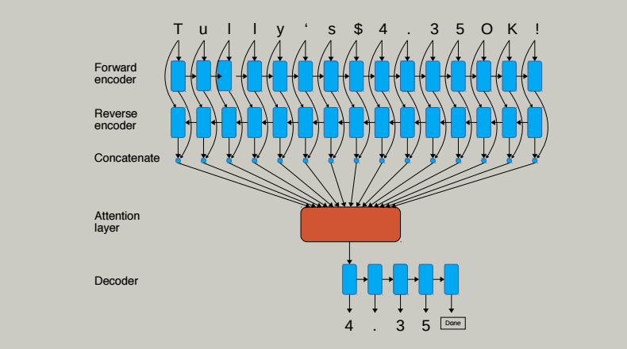
Data Flow
OCR Core Engine
Pre-processing
DPI Enhancement
Segmentation & Feature Extraction
Segmentation using Deep RL
Extract Feature of Character Image using CNN
Classification
Classify & Map the extracted character with best possible symbol using Recurrent Neural Network
Background Removal
Noise Clearing
Post-Processing
Post Processing Rules
Output Format customization
OCR Core Engine
Conversion: JAVA, Python
OCR: Tensor Flow, Tesseract, Google Cloud Vision API, OCRopus
Deep Reinforcement Learning
Convolutional Neural Network
Recurrent Neural Network

